Slide 1
18-447 Computer Architecture Final Review Session
Prof. Onur Mutlu
Carnegie Mellon University
Spring 2015, 5/1/2015

Slide 2
Lab 6 Extra Credit
2.5% Ashish Shrestha (ashresth)
2.5% Amanda Marano (amarano)
2.5% Pete Ehrett (wpe)
2.0% Jared Choi (jaewonch)
2.0% Akshai Subramanian (avsubram)
2.0% Sohil Shah (sohils)
2.0% Raghav Gupta (raghavg)
1.5% Kais Kudrolli (kkudroll)

Slide 3
Course Evaluations (due May 11)
Due May 11, 11:59pm
Please do not forget to fill out the course evaluations
http://www.cmu.edu/hub/fce/
Your feedback is very important
I read these very carefully, and take into account every piece of feedback
And, improve the course for the future
Please take the time to write out feedback
State the things you liked, topics you enjoyed, what you think the course contributed to your learning, what we can improve on
Please don’t just say “the course is hard and fast paced”
Because you knew that from the very beginning!

Slide 4
Extra Credit for Course Evaluations
0.25% extra credit for everyone in the class if more than 90% (i.e., 25) of you fill out the evaluations

Slide 5
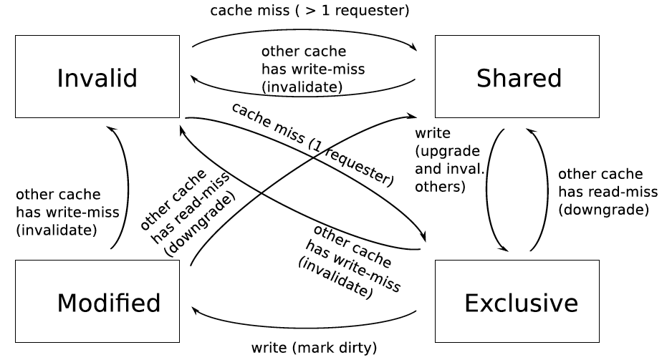
Extra Credit Lab 8: Multi-Core Cache Coherence
Completely extra credit (all get 5% for free; can get 5% more)
Last submission accepted on May 10, 11:59pm; no late submissions
Cycle-level modeling of the MESI cache coherence protocol

Slide 6
Final Exam: May 5
May 5, 5:30-8:30pm, Location: BH A51
Comprehensive (over all topics in course)
Three cheat sheets allowed
We will (likely) have a review session on Friday
Remember this is 22% of your grade
I will take into account your improvement over the course
Know all concepts, especially the previous midterm concepts
Same advice as before for Midterms I and II

Slide 7
Course Grades So Far
AVG = 57
Median = 58
STDDEV = 6.5
Max = 66
Min = 43
Max_possible = 71
Max_possible + EC = 87.15
Notes:
I will guarantee at least the following grades:
A: 90-100
B: 80-90
C: 70-80
D: 60-70
R: 0-60
I may lower the lowest point of a grade range, but not raise them.

Slide 8
A Note on 740, Research, Jobs/Internships
I am teaching 740 next semester (Fall 2015)
Lectures M, W 7:30-9:20pm
Recitations T 7:30-9:20pm
If you are enjoying 447 and are doing well, you can take it
→ feel free to talk with me
If you are excited about Computer Architecture research or looking for a job/internship in this area
→ talk with me

Slide 9
More on 740
740 is the next course in sequence
Time: Lect. MW 7:30-9:20pm, Rect. T 7:30-9:20pm
Content:
Lectures: More advanced, with a different perspective
Recitations: Delving deeper into papers, advanced topics
Readings: Many fundamental and research readings; will do many reviews
Project: More open ended research project. Proposal → milestones → final poster and presentation
Done in groups of 1-3
Focus of the course is the project and critical reviews of readings
Exams: lighter and fewer
Homeworks: None

Slide 10
Lecture Schedule (Second Half)
The memory hierarchy
Caches, caches, more caches
Virtualizing the memory hierarchy: Virtual Memory
Main memory: DRAM
Main memory control, scheduling
Memory latency tolerance techniques
Non-volatile memory
Multiprocessors
Coherence and consistency
In-memory computation and predictable performance
Multi-core issues (e.g., heterogeneous multi-core)
Interconnection networks

Slide 11
Lecture Schedule (First Half)
Fundamentals, ISA, ISA Tradeoffs
Single-cycle Microarchitectures
Multi-cycle and Microprogrammed Microarchitectures
Pipelining
Issues in Pipelining: Control & Data Dependence Handling, State Maintenance and Recovery, …
Out-of-Order Execution
Issues in OoO Execution: Load-Store Handling, …
Alternative Approaches to Instruction Level Parallelism

